Slide 1

The battle between bank branches and economics
Presented by :
Amirfarhang khojasteh

Slide 2
Table of contents
Introduction: Business Problem
Data
Methodology
Analysis
Results and Discussion
Conclusion

Slide 3
Introduction: Business Problem
last summer when I was walking on the street I my hometown suddenly number of banks branch around me attract my attention something I had never note before... so take a look deeper around myself and I found unordinary number of banks in other streets too... I thought that how can I find real number of these banks all around this city then I decide to use map. I claimed that these number of banks is more than number of restaurants so this is unusual because number of cafes and restaurants is more than number of banks in each city of the world's countries! our country suffering a huge economical crisis and unreasonable number of banks in a small city in this crisis can play an important role in consume valuable financial resources.so you can see how lack of management in banking system that we can see signs of that in number of unnecessary bank branches in a small city like arak can influence whole economic in a country... I will try to prove this statement in this project by using maps and locations.

Slide 4
data
Based on definition of our problem, factors that will influence our decision are:
distribution of bank branches on map can help us answer is these branches useless or not?
number of bank branches in each streets to visualize this distribution
number of branches of each bank to see is necessary that each bank has several branches in a small city with population about 484212 (all population include adults).[4].whereas global standard is 12.5 bank branches for every 100,000 adults in 2016.[3]
Following data sources will be needed to extract/generate the required information:
foursquare json data to extract restaurants data and reverse location that found through google map into addresses[5]
address of banks and number of them that downloaded from [1]

Slide 5
Methodology

Slide 6
we collect data of banks in radius 3000 around arak city in foursquare in a json file
and collect data of restaurants in the same way
so extract venues from json and save them to data frame by json_normalize()
but I noted that data of banks that foursquare gave us is not complete because google map show more than 40 banks in arak , on the other hand I couldn’t use google services because Iran can not transfer money according to US sanctions.so I must start collecting bank data and location from another source . So I decide to collect bank names and locations separately by using google map straight(that was the only way that i knew!

Slide 7
so i collected banks addresses from 'ndf' data frame
and enter their location handy from google map one by one
creat a new data frame 'base' with three columns : 1.location 2.lat(latitude) 3.long(longitude) 4.banknames
but i couldn't match addresses in 'ndf' and location in 'base' so create new data frame for addresses that extract it from 'ndf' with droping unnecessary columns then leave it with two columns :"address_1"(include the addresses of banks in persian that i remove spaces between words to find unique value of them and find how many banks is in each street) and "bank"(represent the bank name)

Slide 8
Analysis
Let's perform some basic explanatory data analysis and derive some additional info from our raw data. First let's plot distribution of restaurants and banks collected from foursquare.com in a map :

Slide 9
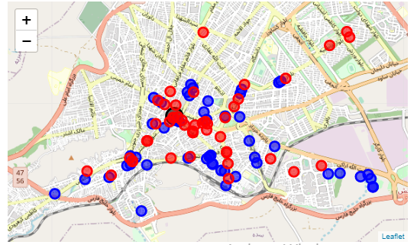
distribution of restaurants and banks collected from foursquare.com in a map

Slide 10
foursquare data couldn't gave me complete data of banks location however this data has enough insight to prove that bank branches has so irregular distribution . And according to global standard determined by World Bank that tell us there were 12.5 bank branches for every 100,000 adults . ARAK city has 500,000 people including adults which for arak number of 12.5 multiple by 5 is equal to 62 bank branches so at first glance there is normal number of them in arak but i want to show real number of banks in data collected by google map and compare it with number of restaurant that indicate as a normal economical activities :

Slide 11
at first I want to compare number of banks and restaurants in foursquare dataset to show unequality between these distribution
then I want to show the audience real data that I collected in "base" dataset and compare the numbers with global standards
and conclude that many of these branches must be closed in a economical crisis and pandemic

Slide 12
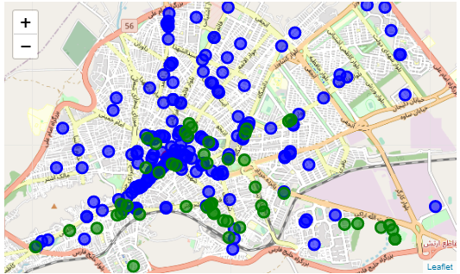

Slide 13
also you can see irregular distribution of bank branches increasingly! we'll discuss about... in this new data we recognize more than 200 bank branches that is 4 times more than standard indicated by World Bank and this is too extra ordinary!

Slide 14
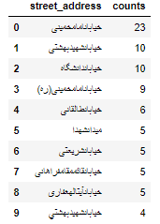
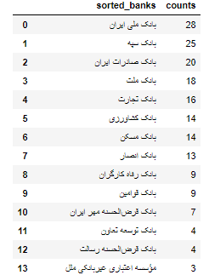
each row represent a street and we have 23 bank branches in one street 'خیابان امام خمینی’ , and so on it’s so unusual also we have more than 30 banks in "newdf_1" data frame according to map more branches cluster at a small area and this show clearly big mistakes in distribution of branches
newdf_2 AND newdf_1

Slide 15
Results and Discussion
number of bank branches are unusually above the standards and i prove it by map and compare them to number of restaurants.it show us that we need businesses like restaurants more than inactive bank branches . on the other hand maps show us distribution of bank branches is so irregular and we could see that larg number of them group near few spots around center of city so i think we need no more bank branches . also we can use online banking automation systems instead . and if we take a look back at map more accurate we will notice that somewhere in city don’t have enough even ATM's or bank branches and people must pass a long way to city center for their purposes.

Slide 16
Now take a look at a part of an economical report published in "eghtesadonline.com" :
"the numbers of bank branches indicate a subtle decline compared to the 23,549 branches reported for February, it is far above world standards . According to a World Bank report, there were 12.5 bank branches in the world for every 100,000 adults in 2016 while the same number for Iran in that year was 31.3. Iran’s average is also more than double the MENA average at 14.7 branches for every 100,000 adults . In comparison, figures for Turkey show it had 18.1 bank branches for the same number of people while the number for China was 8.8.If it wants to come near the global average, Iran should bring down the number of bank branches to 8,868, which means closing 11,730 branches . To reach the MENA average, a total of 10,169 branches should have been reduced to bring the total to 10,429 in 2016."[3]

Slide 17
Conclusion
Purpose of this report is show what number of bank branches and their distribution is irregular and unreasonably in the economy is in crisis . we have more than 30 banks in a small city and each person has an account in one or more of them , also they grouped a near area around city center . governers as first step must correct their distribution and in the second step must close at least half of them and they can merge banks together to save in cost and help economy get better.

Slide 18
I think that what if bankers turn their useless branches into ordinary businesses like restaurant or technology centers or centers to group peoples with same level of thinking together for discussion and start learning new things. somewhere like universities without any protocol , because we don’t have a specific place to make together and cafes and restaurants are expensive and if you want to talk somebody about computer and serious problems you cant find comfort place like universities ecosystem(I wish join these active ecosystem sometime somewhere...)

Slide 19
Reference :
[1] = https://www.cbi.ir/BanksInstitutions/BankInstitute.aspx
[2] = https://www.google.com/maps
[3] = https://www.en.eghtesadonline.com/Section-economy- 4/30257-iran-no-need-for-so-many-bank-branches
[4] = https://www.amar.org.ir
[5] = https://www.foursquare.com

